Slide 1

MySQL PROJECT
Present By: Aditya Ugale
Hardik More
Guided By : Vrushali Sarwan

Slide 2



Case Study on IMDB movie Dataset

Slide 3

IMDb-Internet Movie Database is an online database of information related to films, television series, podcasts, home videos, video games, and streaming content online – including cast, production crew and personal biographies, plot summaries, trivia, ratings, and fan and critical reviews. Dataset contains - 830 rows 11 Column
Project Description

Slide 4
IMDb began as a fan-operated movie database on the Usenet group "rec.arts.movies" in 1990, and moved to the Web in 1993. Since 1998, it has been owned and operated by IMDb.com, Inc

Slide 5

Display year and no of movies per year
select Year, count(year) from IMDB group by year order by year;

Slide 6

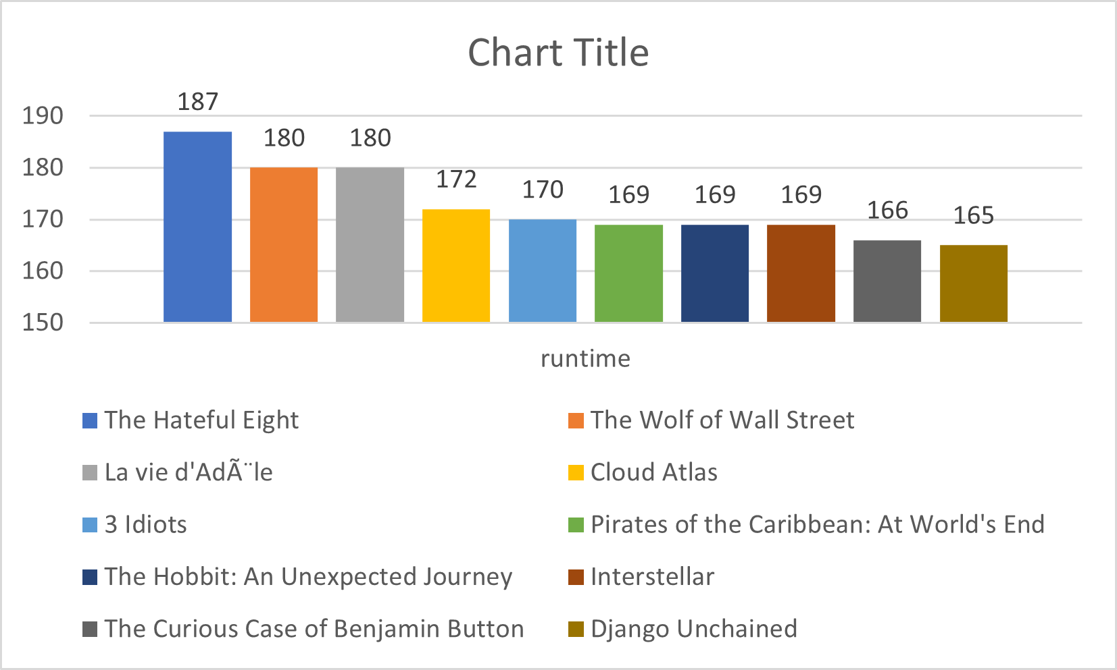
Top 10 Longest Runtime movie
select title , runtime from IMDB where year>=2006 and year<=2016 order by runtime desc limit 10;

Slide 7

Top 10 director who makes most movies
select director, count(director) from IMDB group by director order by count(director) desc limit 10;

Slide 8

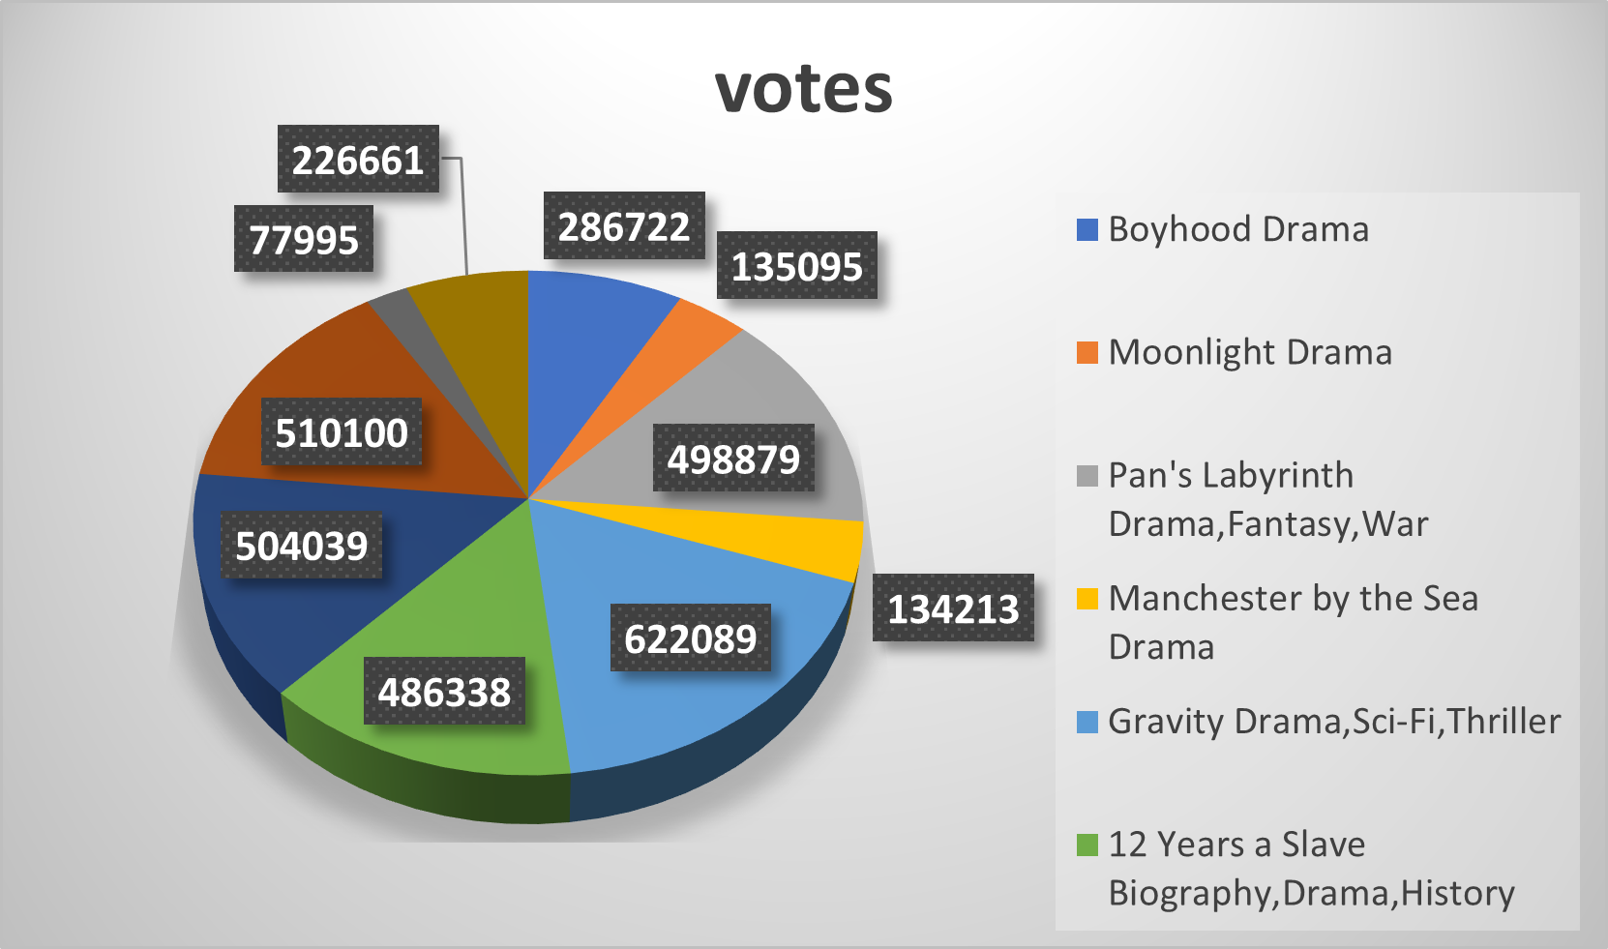
CHECKING FOR THE TOP 10 MOVIES,GENRES WITH HIGHEST VOTE AND HOW THEY COMPARE TO METASCORE
select title , genre, votes,
metascore from IMDB order by metascore desc limit 10;

Slide 9

Display year by average movie rating
SELECT Year, AVG(Rating) AS Average Rating FROM IMDB
GROUP BY Year limit 10;

Slide 10


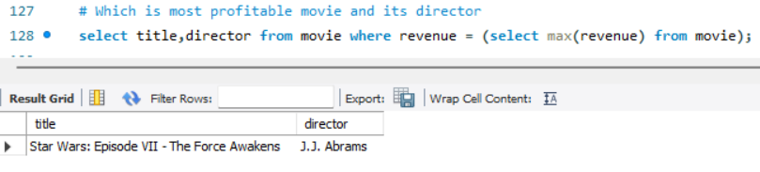


Which is Most Profitable Movie and who is director of that movie
Director – J.J. Abrams

Slide 11

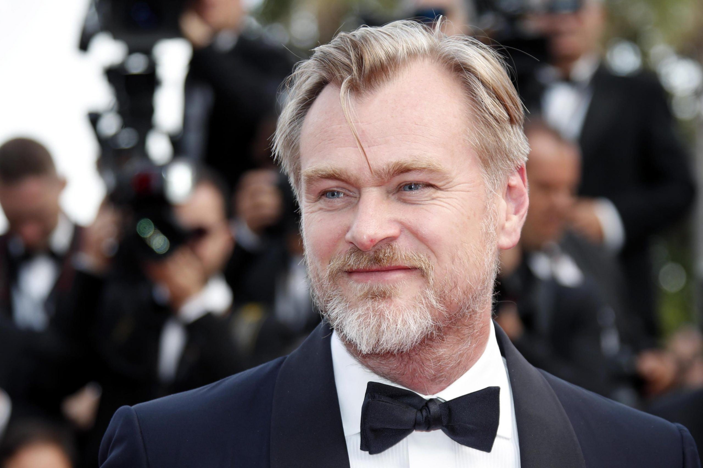





Display movie name whose director got highest rating
The Prestige
Interstellar
Inception
The Dark Knight Rises
The Dark Knight
Christopher Nolan
This Photo by Unknown Author is licensed under CC BY-NC-ND

Slide 12


Thank you!
Any Questions!!!!

